Slide 1
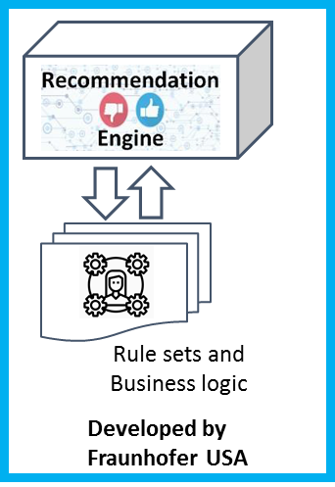
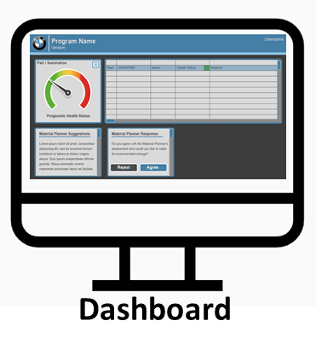
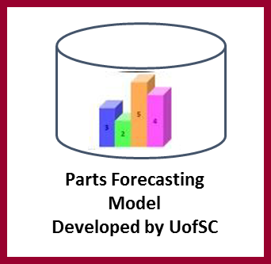
Demonstration Steps
The team will develop a story based on the historical data in the cloud data hub that will step through the planner’s experience when the sit down to work. The demonstration will then highlight the 3 components:
3
1
2
Dashboard built on a dataset from the cloud data hub. Will show how a planner will view the status of the materials/parts they are managing. The demo will show how the planner interacts with the dashboard and views the detailed part information, status (from parts forecasting model, a more detailed view will follow), exceptions, and recommendations (from recommendation engine, a more detailed view will follow).
After the dashboard has been presented, the team will then give a more detailed look at the parts forecasting model and demonstrate the functionality.
After presenting the parts forecasting model, the team will then give a more detailed look at the recommendation engine and demonstrate the functionality

Slide 2
Action Items
Owner | Action Item | Date (due no later than) | Deliverable
Rhea/Josh | Finalize Agenda | 01/05/22 | Agenda
Rhea | Build presentation with input from team | 01/10/22 (draft for review) | Slides
UofSC | Finalize data set for dashboard that highlights functionality | 01/05/22 | Dataset
UofSC | Finalize dashboard for demonstration | 01/12/22 | Dashboard
UofSC | Finalize parts forecasting model for demonstration | 01/12/22 | Web service
Fraunhofer | Finalize recommendation engine for demonstration | 01/12/22 | Web service
Fraunhofer | Sample JSON and details, send to UofSC team | 01/03/22
UofSC | Integrate recommendation engine details into dashboard | 01/05/22

